Slide 1
Autonomous Vehicle code
Data capture, training the model, deploy
Gene Olafsen

Slide 2
Capture
Car and Gamepad

Slide 3
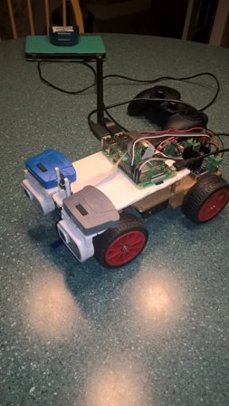
The Platform
Car
Gamepad

Slide 4
IO Library and Gamepad controller
The EVDEV package provides bindings to the generic input event interface in Linux. The evdev interface serves the purpose of passing events generated in the kernel directly to userspace through character devices that are typically located in /dev/input/.
from evdev import InputDevice, categorize, ecodes
gamepad = InputDevice('/dev/input/event0')

Slide 5
Setup common
A call is made to the common library to initialize the servo library and establish camera parameters.
def setup():
global pwm
pwm = servo.PCA9685()
pwm.set_pwm_freq(60)
global camera
camera = PiCamera(resolution=(FRAME_W,FRAME_H))
camera.video_stabilization = False
camera.framerate = 30

Slide 6
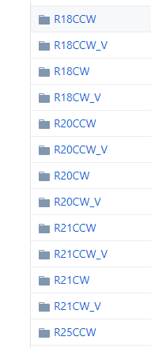
Name the trial
A naming convention is important to organize the captured test and validation data.
R#CW
R#CW_V
R#CCW
R#CCW_V

Slide 7
More setup
def setup_capture():
os.system('mkdir ' + CAPTURE_DIR)
os.system('mkdir ' + CAPTURE_DIR + '/' + str(TRIAL))
os.system('mkdir ' + CAPTURE_DIR + '/' + str(TRIAL) + '/image')
os.system('mkdir ' + CAPTURE_DIR + '/' + str(TRIAL) + '/steer')
def setupMotor(busnum=None):
pwm.frequency = 60
forward0 = 'True'
forward1 = 'True'
GPIO.setwarnings(False)
GPIO.setmode(GPIO.BOARD)

Slide 9
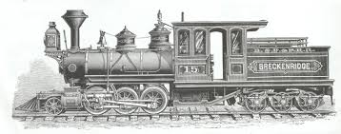
Train
Machine learning works by finding a relationship between its features (input) and a label (output). The model is 'shown' examples from a dataset. Each example helps define how each feature affects the label.

Slide 10
Keras Training
Keras provides three functions that can be used to train deep learning models:
.fit
.fit_generator
.train_on_batch

Slide 11
fit
Trains the model for a given number of epochs (iterations on a dataset).
This command looks similar to the syntax used in scikit learn library
Accepts training data (x) and label information (y)
Defaults are shown below:
fit(x=None, y=None, batch_size=None, epochs=1, verbose=1, callbacks=None, validation_split=0.0, validation_data=None, shuffle=True, class_weight=None, sample_weight=None, initial_epoch=0, steps_per_epoch=None, validation_steps=None)

Slide 12
Limitations to being 'fit'
The call to .fit makes two primary assumptions:
The entire training set can fit into RAM
There is no data augmentation going on (i.e., there is no support for Keras generators)
Why is data augmentation important?... Data augmentation is a form of regularization and it helps avoid overfitting and increases the ability of the model to generalize.

Slide 13
Advantages of being 'fit'
The perfect choice for small data sets.
Batching of data is handled automatically by 'fit' at the cost of having to hold the training set in memory.

Slide 14
Fit_generator
Trains the model on data generated batch-by-batch by a Python generator (or an instance of Keras.utils.Sequence).
fit_generator(generator, steps_per_epoch=None, epochs=1, verbose=1, callbacks=None, validation_data=None, validation_steps=None, class_weight=None, max_queue_size=10, workers=1, use_multiprocessing=False, shuffle=True, initial_epoch=0)

Slide 15
Advantage fit_generator
The generator is run in parallel to the model, for efficiency. For instance, this allows for real-time data augmentation on images on CPU in parallel to training your model on GPU.
The use of keras.utils.Sequence guarantees the ordering and guarantees the single use of every input per epoch when using use_multiprocessing=True.

Slide 16
FIt_Generator yeild
Keep in mind that a Keras data generator is meant to loop infinitely — it should never return or exit.
Since the function is intended to loop infinitely, Keras has no ability to determine when one epoch starts and a new epoch begins.
Therefore, compute the steps_per_epoch value as the total number of training data points divided by the batch size. Once Keras hits this step count it knows that it’s a new epoch.

Slide 17
Train_on_batch
Offers fine-grain control over the Keras training process. The function accepts a single batch of data, performs backpropagation, and then updates the model parameters
train_on_batch(x, y, sample_weight=None, class_weight=None)

Slide 18
Epoch, batch, iteration
Epoch - Is when an ENTIRE dataset is passed forward and backward through the neural network only ONCE.
Batch Size - Total number of training examples present in a single batch.
Iteration - The number of batches needed to complete one epoch.

Slide 19


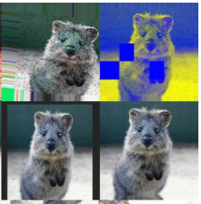
imagaug
A python library that helps with augmenting images for machine learning projects. It converts a set of input images into a new, much larger set of slightly altered images.
https://github.com/aleju/imgaug

Slide 20
Imagaug code
sometime = lambda aug: iaa.Sometimes(0.3, aug)
sequence = iaa.Sequential([
sometime(iaa.GaussianBlur((0, 1.5))),
sometime(iaa.Sharpen(alpha=(0, 1.0), lightness=(0.75, 1.5))),
sometime(iaa.AdditiveGaussianNoise(loc=0, scale=(0.0, 3.), per_channel=0.5)),
sometime(iaa.Dropout((0.0, 0.1))),
sometime(iaa.CoarseDropout((0.10, 0.30), size_percent=(0.02, 0.05), per_channel=0.2)),
sometime(iaa.Add((-10, 10), per_channel=0.5)),
],
random_order=True # do all of the above in random order
)

Slide 21
normalize/equalize
Typically improves the image contrast by spreading pixel values across the full range of the picture.
https://docs.opencv.org/3.2.0/d5/daf/tutorial_py_histogram_equalization.html

Slide 22
Normalize/equalize code
def equalize(image):
norm=np.zeros((image.shape), np.float32)
norm[:,:,0]=cv2.equalizeHist(image[:,:,0])
norm[:,:,1]=cv2.equalizeHist(image[:,:,1])
norm[:,:,2]=cv2.equalizeHist(image[:,:,2])
return norm
def normalize(image):
image = image - np.mean(image, axis=(0,1))
image = image / np.std( image, axis=(0,1))
return image

Slide 23

Recolor line
Well this is quite a training-data specific data augmentation routine! By sampling the RGB values that represent the 'training line color' the routine re-colors 'most' of the line with a random color.
Note: It could be better if it varied the target color in some way proportional to the characteristics of the underlying color.

Slide 24
Recolor code
70% of the time the image is altered with this code.
def recolor_line(data):
color = list(np.random.choice(range(256), size=3))
# generate a random replacement color
blue, green, red = data[:,:,0], data[:,:,1], data[:,:,2]
mask = (red > 200) & (red < 230) & (green > 150 ) & (green < 195) & (blue > 150) & (blue < 195)
data[:,:,:3][mask] = color
return(data)

Slide 25
Image shift
50% of the time, the image is altered with this code.
if np.random.random() > 0.5:
shift = np.random.randint(-2,2)
if shift > 0:
image[-shift:,:,:] = 0
image[:-shift,:,:] = image[shift:,:,:]
elif shift < 0:
image[:-shift,:,:] = 0
image[-shift:,:,:] = image[:shift,:,:]

Slide 26
image flip
50% of the time, the image is altered with this code.
if np.random.random() > 0.5:
image = cv2.flip(image, 1)
steer = -steer

Slide 27
Compile the model
Model is instructed to use a custom loss function.
minimizer = SGD(lr=0.0001)
#model.compile(loss=custom_loss, optimizer=minimizer)
model.compile(loss=custom_loss, optimizer='adam')
#model.compile(loss=losses.mean_squared_error, optimizer='adam')

Slide 28
Custom loss function(s)
def custom_loss(y_true, y_pred):
# custom loss 1
#y_pred = tf.clip_by_value(y_pred, -1+1e-7, 1-1e-7)
#loss = -((1. - y_true) * tf.log(1. - y_pred) + (1. + y_true) * tf.log(1. + y_pred))
#loss = tf.reduce_mean(loss)
# custom loss 2
loss = tf.square(y_true - y_pred)
loss = .5 * tf.reduce_mean(loss)
# custom loss 3
#loss = tf.abs(y_true - y_pred)
#loss = tf.reduce_mean(loss)
return loss

Slide 29
Fit_Generator
assdf
history = model.fit_generator(generator = gen_train.get_gen(),
steps_per_epoch = num_train,
epochs = 10,
verbose = 1,
validation_data = gen_valid.get_gen(),
validation_steps = num_valid,
callbacks = [early_stop, checkpoint, tensorboard],
max_q_size = 3)

Slide 30
The model
image_inp = Input(shape=(FRAME_H, FRAME_W, 3))
x = Conv2D(filters=8, kernel_size=(5, 5), activation='relu')(image_inp)
x = MaxPooling2D((2, 2))(x)
x = Conv2D(filters=16, kernel_size=(5, 5), activation='relu')(x)
x = MaxPooling2D((2, 2))(x)
x = Conv2D(filters=32, kernel_size=(5, 5), activation='relu')(x)
x = MaxPooling2D((2, 2))(x)
x = Flatten()(x)
x = Dropout(.5)(x)
x = Dense(128, activation = 'relu')(x)
x = Dropout(.5)(x)
x = Dense(1, activation='tanh')(x)
angle_out = x

Slide 31
Kernel size
Best practices for selecting kernel size

Slide 32
Filter selection
Best practices for selecting filter parameters

Slide 33
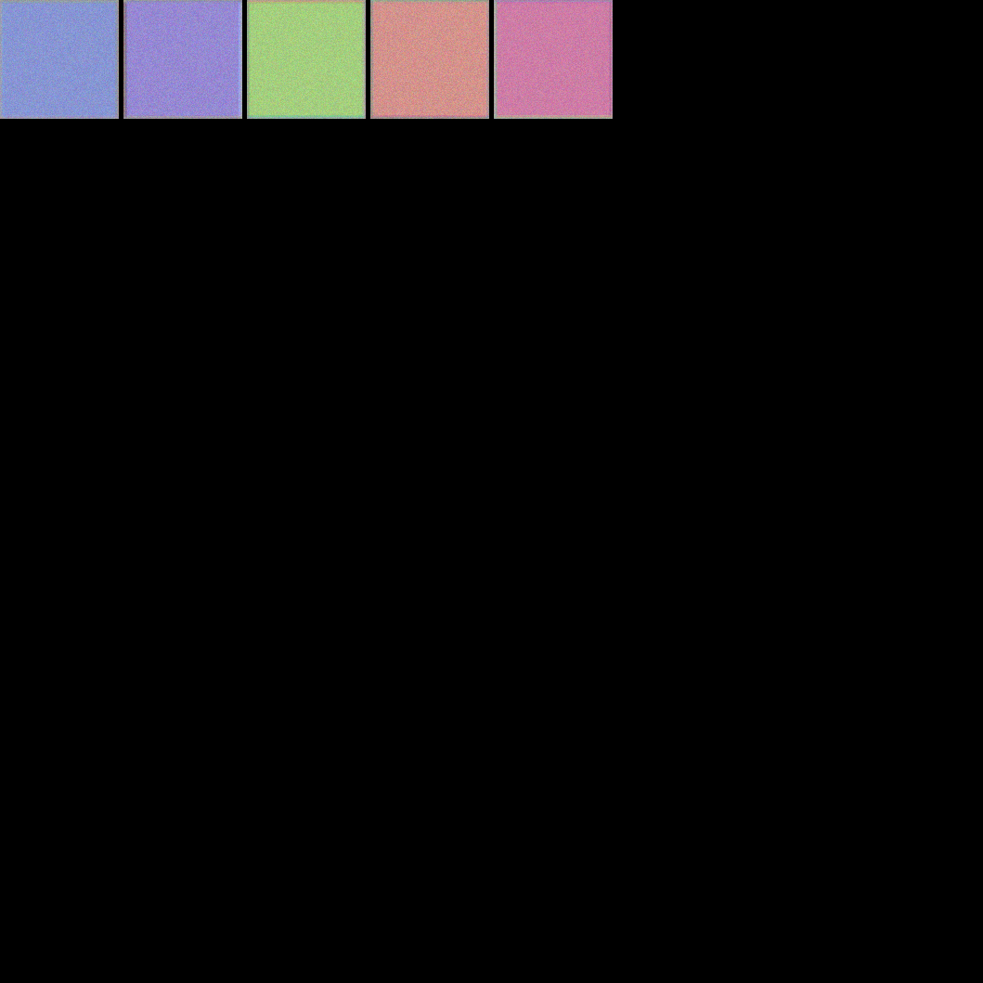
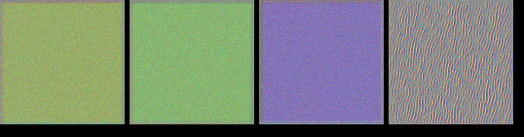
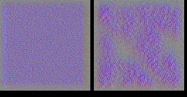
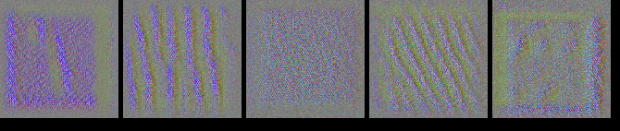
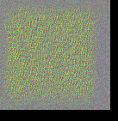
Filter images
Training without Re-color Re-color Training
CONV2D – 1
CONV2D – 2
CONV2D – 3

Slide 34
Determining the filter parameter
There is no easy way to choose the number of filters. I'd like to share one of my favorite sanity checks on the number of filters. It takes 2 easy steps:
Try to overfit at 500 random images with regularization.
Try to overfit at the whole dataset without any regularization.
Usually - if the number of filters is too low (in general) - these two tests will show you that. If - during your training process - with regularization - your network severely overfits - this is a clear indicator that your network has way too many filters.
https://stackoverflow.com/questions/48243360/how-to-determine-the-filter-parameter-in-the-keras-conv2d-function

Slide 35
Regularization
Kera Regularization options

Slide 36
Pooling layers
The Keras.layers.MaxPool2d method is used.
Reduces the dimensionality by a factor of 4.
The pooling layer is a method to tell the neural-network to expect some invariance in the position of features within the instance (video frame) that is being processed.

Slide 37
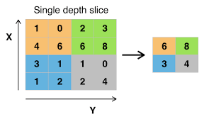
Where to put a pooling layer
the common way the pooling layer is used is after a convolution layer. In this case, the convolution layer tries to identify some important structure in some region of the data while the pooling layer obscures the exact location of this structure.

Slide 38
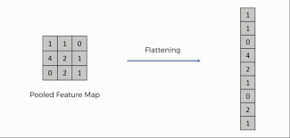
Flatten later
Keras.layers.Flatten reduces the tensor to a single dimension whose shape is equal to the number of elements of the tensor.
ImageH * ImageW * rgb = 90*180*3 = 48,600
keras.layers.Flatten(data_format=None)

Slide 39
Flatten's position in the model
The last stage of a Convolution Neural Network (CNN) is a classifier.
Flatten takes the output of the CNN and 'flattens' its structure to create a single long feature vector. This dense representation is the input to the Artificial Neural Network (ANN) classifier.
The flattening step is needed to make use of fully connected layers after the convolutional layers. Fully connected layers don't have a 'local' limitation like convolutional layers (which only observe some local part of an image by using convolutional filters)

Slide 40
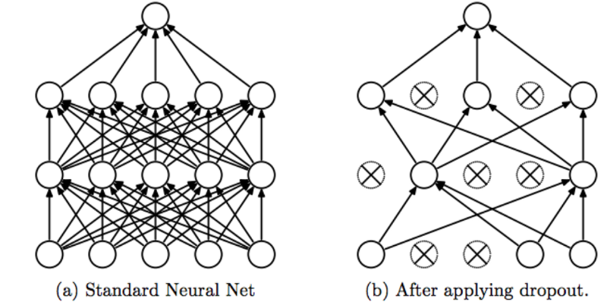
Dropout layer
Keras.layers.Dropout refers to ignoring units (i.e. neurons) during the training phase of certain set of neurons which is chosen at random.
Dropout is a regularization technique, which aims to reduce the complexity of the model with the goal to prevent overfitting
Dropout curbs the individual power of each neuron. It helps reduce a co-dependency relationship between neurons.
keras.layers.Dropout(rate, noise_shape=None, seed=None)

Slide 41
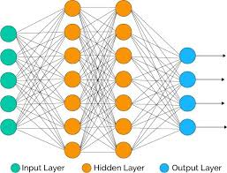
Dense layer
Keras.layers.Dense - A dense layer is simply a layer where each unit or neuron is connected to each neuron in the next layer
keras.layers.Dense(units, activation=None, use_bias=True, kernel_initializer='glorot_uniform', bias_initializer='zeros', kernel_regularizer=None, bias_regularizer=None, activity_regularizer=None, kernel_constraint=None, bias_constraint=None)

Slide 42
Instantiate a model object
Define the model input and output.
Display a summary of the model configuration.
model = Model(inputs=[image_inp], outputs=[angle_out])
model.summary()

Slide 43
Keras Callbacks
A callback is a set of functions to be applied at given stages of the training procedure. Use callbacks to get a view on internal states and statistics of the model during training.
early_stop = EarlyStopping(monitor='val_loss', min_delta=0.001, patience=2, mode='min', verbose=1)
checkpoint = ModelCheckpoint('weights.hdf5', monitor='val_loss', verbose=1, save_best_only=True, mode='min', period=1)

Slide 44

Generators
Define a generator for training data, and another for validation.
gen_train = BatchGenerator(session_t, batch_num)
gen_valid = BatchGenerator(session_v, batch_num, augment = False)
# the validation data set does not modify the image

Slide 45
Drive
The vehicle can drive autonomously by loading the trained model and weights and then 'fed' video of the line placed on the ground. The model will output the predicted steering angle.

Slide 46
Load the model
Load one of the trained models... some perform better than others!
print('begin model load...')
model = keras.models.load_model('weights12-7-18.hdf5', custom_objects=customObjects) # well defined model with good training data
#model = keras.models.load_model('weights11-11-18.hdf5', custom_objects=customObjects) # poorly defined model with good training data
#model = keras.models.load_model('weightsLane11-24-18.hdf5', custom_objects=customObjects) # poorly defined model with poor training data
print('model loaded')

Slide 47
Configure the Hardware
Setup the camera and the motors.
car.setup()
rawCapture = PiRGBArray(car.camera, size=(car.FRAME_W, car.FRAME_H))
time.sleep(0.1)
counter = 0
print('Calibrated steering - centered now')
car.setupMotor()
car.get_pwm().set_pwm(0, 0, 410)

Slide 48
Prompt for the forward speed
The model is trained with a forward speed of '37'. Any speed much lower than 37 will cause the drive motors to stall... especially on carpet.
FORWARD_SPEED = int(input('Enter speed (minimum is about 37):'))
car.setSpeed(FORWARD_SPEED)
car.backward() # yes, the motors are wired in reverse!

Slide 49
model prediction loop
for frame in car.camera.capture_continuous(rawCapture, format="bgr", use_video_port=True):
# Grab the raw NumPy array representing the image
image = frame.array
#cv2.imshow("Frame", image) -- if executing from an X-Server this will show the camera's view
# Pre-process the image
net_inp = np.expand_dims(normalize(image[:]), 0)

Slide 50
process model instance and set steering angle
# Drum roll please... here is where the magic happens!
net_out = model.predict(net_inp)[0][0]
#print('predicted angle ', net_out)
# Send PWM signal to servo
if math.isnan(net_out) == False:
steer = int(net_out * (STEER_UPPER - STEER_MIDPT) + STEER_MIDPT)
# print ('Predicted Angle:', steer)
car.get_pwm().set_pwm(0, 0, steer)

Slide 51
Cleanup and get ready to process again
# additional training data can be collected by writing the self-driving results
if RECORD:
cv2.imwrite('demo/image/' + str(counter).zfill(6) + '.png', image)
with open('demo/steer/' + str(counter).zfill(6) + '.txt', 'w') as steer_file:
steer_file.write(str(steer*10))
counter += 1
# Clear the stream in preparation for the next frame
rawCapture.truncate(0)
# If the `q` key was pressed, break from the loop
key = cv2.waitKey(1) & 0xFF
if key == ord("q"):
print('quit - stopping car')
car.stop()
break

Slide 52
YOLO
You only look once (YOLO) is a state-of-the-art, real-time object detection system.
Adding YOLO to the self-driving vehicle to detect people.

Slide 53
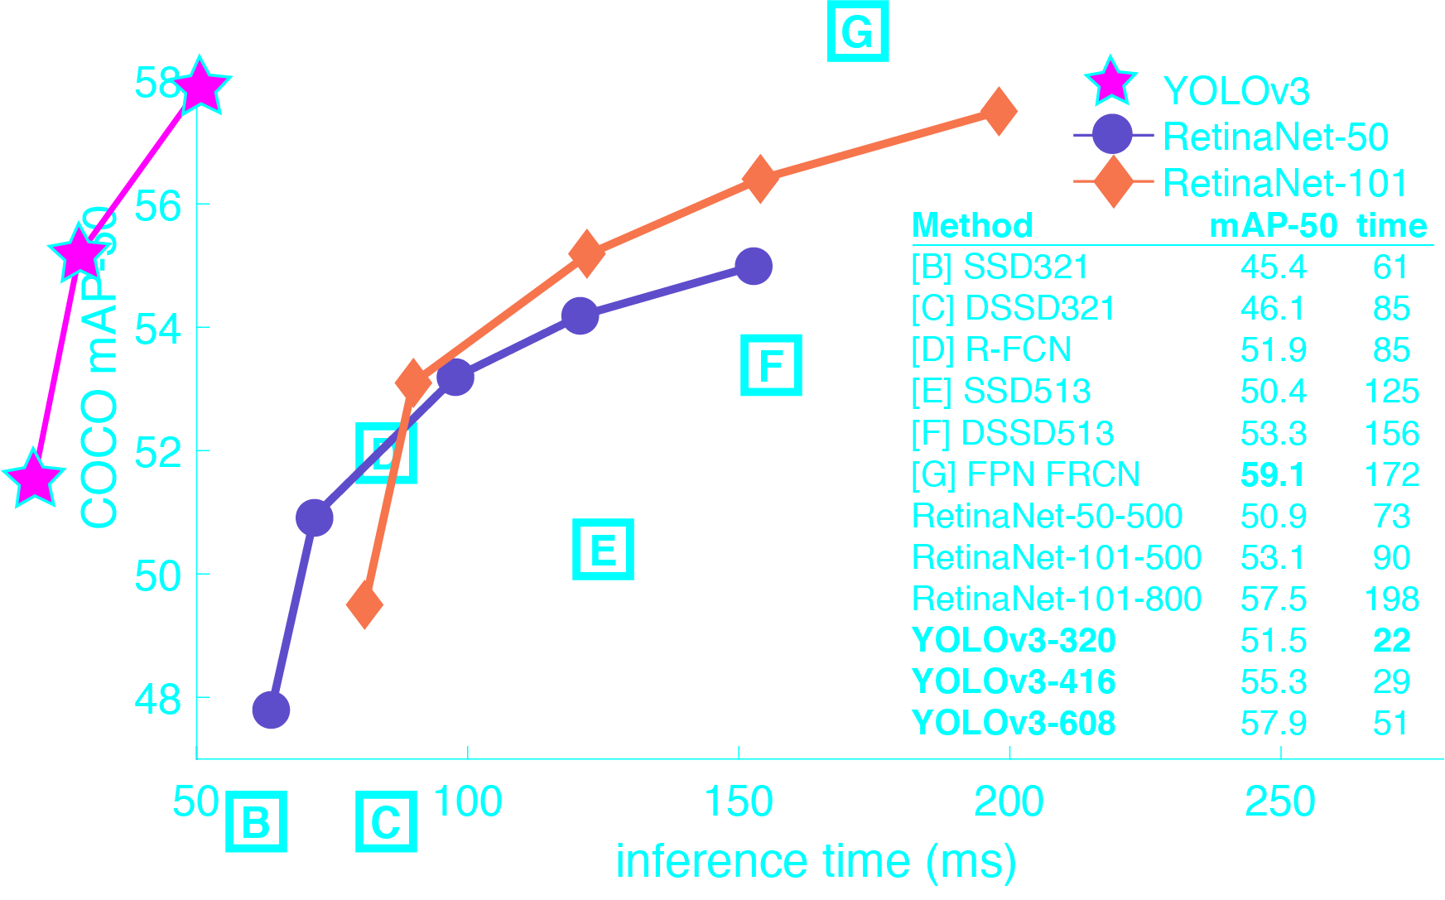
Comparison to Other Detectors
YOLOv3 is extremely fast and accurate. In mAP measured at .5 IOU YOLOv3 is on par with Focal Loss but about 4x faster. Moreover, you can easily tradeoff between speed and accuracy simply by changing the size of the model, no retraining required!

Slide 54
processing speed on Raspberry pi
Threading... nope.
Approx. One frame analyzed every 2.3 seconds

Slide 55
Image recognition on laptop
Web-server on Raspberry PI
Image is pulled by laptop and analyzed in 'real-time'
Stop command is given to car. (Pull a 'stop' page)

Slide 56
Transfer learning
Teach YOLO to recognize road signs.

Slide 57
Reinforcement learning and Self-Driving
In the reinforcement learning problem, the goal is to find a good behaviour, an action or a label for each particular situation, to maximize the long-term benefits that the agent receives.

Slide 58

Autonomous driving rewards
Keep the line in the field of view...

Slide 59
Create a training environment
Collect images of all the possible turn radius that the platform is capable of turning.
Collect 'floor/surface' images without a line.
Render a 'line' on top of floor surface images.
Simulate 'steering and forward' motion with various steering angles
Define reward function

